Slide 1




Algorithm
Term project
-proposal
Group B

Slide 2



TABLE OF
CONTENTS
Algorithm Term Project
03 Team member & Roles
04 Setting goals
05 About used language
06 Algorithm
07 Progress
08 Next steps..
02

Slide 3
TEAM MEMBER
Group B
Algorithm Term Project
All team members participated in research, discussions about the algorithm, and the development of the algorithm’s operational process!
강민준
류혁
송민의
이동호
Code Writing, Algorithm Implementation
ppt production, data research
ppt production, data research
Code Writing, Algorithm Implementation
03

Slide 4




SETTING
GOALS
Algorithm Term Project
Movie recommendations
04
Personalized Recommendation
Algorithm
Clustering
Recommend movies customized to each user’s preferences.
Using Kruskal’s Algorithm
Clustering through Weigh Configuration

Slide 5

Distinctive Aspects of the Current Program
2030 COMPUTER AND PROGRAMMING
Based on the similarity between inter users, the modern general recommendation system has a disadvantage that it is difficult to recommend to a small number of people at the beginning. To compensate for this shortcoming, we will be able to create an algorithm that can recommend reliable movies even if there is only one user by clustering movies in advance based on information previously released on the web.
05

Slide 6
About Used Language
Algorithm Term Project
Python
Using Python and the scikit-learn library for straightforward one-hot (effectively multi-hot) encoding of movie genre tags to simplify the process of calculating similarity.
06

Slide 7
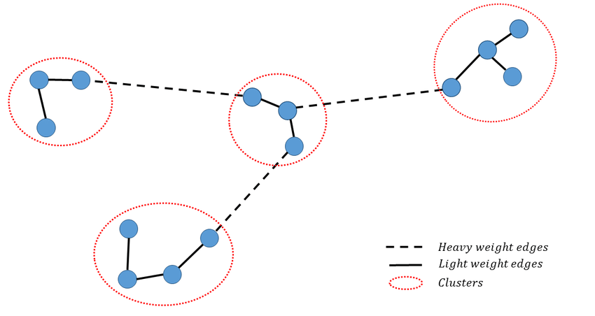

Algorithm
Kruskal’s Algorithm
Kruskal’s algorithm is used to find the Minimum Spanning Tree (MST) of a weighted connected graph.
A Minimum Spanning Tree connects all nodes of the graph with the least possible cost.
2030 COMPUTER AND PROGRAMMING
Utilizing Kruskal’s algorithm, where high-weight edges are removed to form clusters, we design a recommendation program.
Movies are modeled as nodes, and the similarity between movies is represented as the weight of the edges.
Why Kruskal’s Algorithm
Efficient and Intuitive
With that said, Kruskal’s algorithm sorts edges by weight and builds a minimum spanning tree by selecting the lowest-weight edges first.
By applying this algorithm, we can set similarity between movies as weights and form an optimal connection structure, enabling us to provide an efficient and intuitive movie recommendation system.
07

Slide 8




Progress
Algorithm Term Project
DB
Recommendation
Clustered nodes
Using a database from KMDB that includes Korean movie titles and genres post-2000.
Using the above database, form an MST using Kruskal’s algorithm based on weight criteria.
08
Form clusters by removing edges with high weights.
Upon entering a movie name included in the database, select the corresponding cluster, and recommend a movie that represents the closest movie within that cluster.

Slide 9
Next steps..
Algorithm Term Project
Goal : Serendipity
The ultimate goal of our recommendation system is to provide users with an experience where they can encounter a diverse array of genres and styles without being confined to a particular taste. Through this, users can cultivate a curiosity for new works and enjoy a broader cinematic experience!
09

